Slide 1


Computer
Fundamentals
Dr. Safdar Nawaz Khan
Marwat
DCSE, UET
Peshawar
Lecture 2
safdar@uetpeshawar.edu.pk

Slide 2
Looking Inside the Computer
System
➢ The parts of a computer system
➢ The information processing cycle
➢ (Essential computer) hardware
➢ Software
➢ Computer
➢ Computer
(brings
data
users
the
machine
to
life)
safdar@uetpeshawar.edu.pk
2

Slide 3
Parts of the Computer
System
➢ Computer systems have
❑ Hardware
❑ Software
❑ Data
❑ User
four parts
➢ No
matter
how
small
or
large
the
computer
safdar@uetpeshawar.edu.pk
3

Slide 4
Parts of the Computer
System
(cont.)
➢ Hardware
❑ Mechanical devices in computer
❑ Anything that can be touched
➢ Software
❑ Tell the computer what to do
❑ Also called a program
❑ System Software vs. Application
Software
❑ Thousands
of
programs
exist
safdar@uetpeshawar.edu.pk
4

Slide 5
Parts of the Computer System (cont.)
➢ Data
❑ Pieces of information but may not make much sense
❑ Computer process, converting them
➢ Users
❑ People operating the computer
❑ Most important part
to
useful
information
❑ Tell
the
computer
what
to
do
safdar@uetpeshawar.edu.pk
5

Slide 6
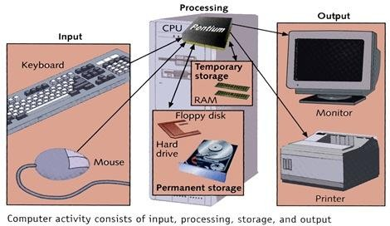
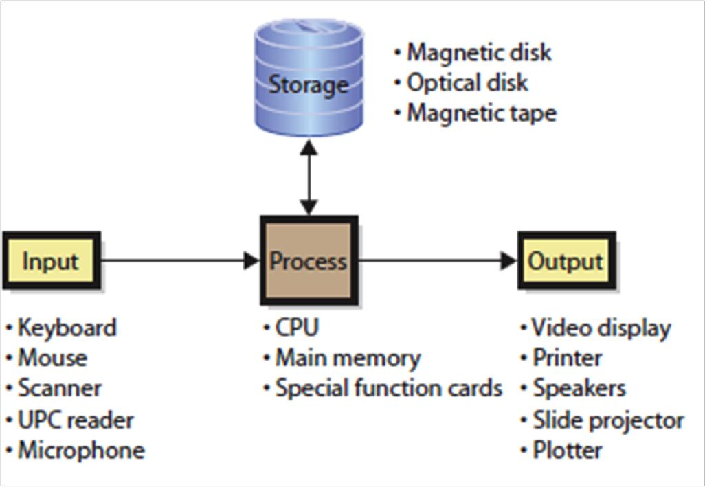
Information Processing
Cycle
➢ Steps followed
❑ Input
❑ Processing
❑ Output
❑ Storage
to
process
data
Source: http://driverlayer.com
safdar@uetpeshawar.edu.pk
6

Slide 7
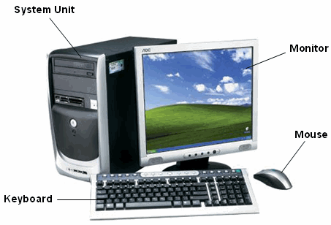
Essential Computer Hardware
➢ Computers
use
the
same
basic
hardware
Source: http://www.computerguidekey.com
safdar@uetpeshawar.edu.pk
7

Slide 8
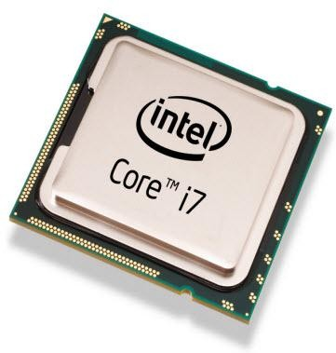
Essential Computer Hardware
(cont.)
➢ Processing devices
❑ Processor, brain of computer
❑ Carries out instructions from program
❑ Manipulate data
❑ Most computers have several processors
o Central Processing Unit (CPU)
o Secondary processors
❑ Processors made of silicon
and
copper
❑ Plugged
into
motherboard
Source: https://www.elprocus.com/microprocessor-history-and-brief-information-about-its-generations
safdar@uetpeshawar.edu.pk
8

Slide 9
Essential Computer
Hardware
(cont.)
➢ Memory devices
❑ Stores data or programs
❑ Random Access Memory (RAM)
o Volatile
o Stores current data and programs
o More RAM results in a faster system
❑ Read Only Memory (ROM)
o Permanent storage of programs
o Holds the computer boot directions
safdar@uetpeshawar.edu.pk
9

Slide 10
Essential Computer
Hardware
(cont.)
➢ Input and output devices
❑ Allows the user to interact
❑ Input devices accept data
o Keyboard, mouse
o Trackball, touchpad, joystick
o Scanner, digital camera, microphone
❑ Output devices deliver data
o Monitor, printer, speaker
❑ Some devices are input
o Touch screens
o Communication devices
and
output
safdar@uetpeshawar.edu.pk
10

Slide 11
Essential Computer Hardware
(cont.)
➢ Storage devices
❑ Hold data and programs permanently
❑ Different from RAM
❑ Magnetic storage
o Floppy and hard drive
o Uses a magnet to access data
❑ Optical storage
o CD and DVD drives
o Uses a laser to access data
❑
Flash Drive
o Flash memory stores information in an array of memory cells
safdar@uetpeshawar.edu.pk
11

Slide 12
Software Runs the Machine
➢ Tells the computer what to do
➢ Reason people purchase
➢ Two types
❑ System software
computers
❑ Application
software
safdar@uetpeshawar.edu.pk
12

Slide 13
Software Runs the
Machine
(cont.)
➢ System software
❑ Most important software
❑ Operating system
o Windows XP, Windows 7 & 8
❑ Network operating system (OS)
o Windows Server 2003, Unix (Linux,
❑ Utility
o Symantec AntiVirus
ubuntu)
safdar@uetpeshawar.edu.pk
13
13

Slide 14
Software Runs the
Machine
(cont.)
➢ Application software
❑ Accomplishes a specific task
❑ Most common type of software
o MS Word
o MS Excel
❑ Covers
most
common
uses
of
computers
safdar@uetpeshawar.edu.pk
14

Slide 15
Computer Data
➢ Data defined as
❑ Individual or raw facts
❑ Pieces of information
❑ May not make much sense
❑ Data processed by computer
➢ Fact with no meaning on its
own
❑ Alphabets may not mean a lot individually
❑ Arranging them to form words and sentences
➢ Stored using the binary number system
❑ Data can be organized into files
is useful information
➢ Data converted to useful information by computer
➢ Decision taken based on information is knowledge
safdar@uetpeshawar.edu.pk
15

Slide 16
Computer
Data
(cont.)
City
Karachi
Peshawar
Islamabad
Lahore
Quetta
Murree
Data
Season
Spring
26
26
24
27
13
10
Summer
35
41
39
43
26
20
Autumn
21
22
19
25
11
8
Winter
17
4
3
8
1
-5
Information
Average temperatures of cities
Average temperatures of seasons
50
Spring
Summer
Autumn
Winter
50
Karachi
Peshawar
Islamabad
Lahore
Quetta
Murree
40
40
30
30
Centigrade
Centigrade
20
20
10
10
0
0
Knowledge
Karachi Peshawar Islamabad Lahore Quetta
Murree
Spring
Summer
Autumn
Winter
-10
-10
➢ Murree’s weather is cold
➢ Summer is a hot season
safdar@uetpeshawar.edu.pk
16

Slide 17
Computer Users
➢ Role depends on ability
❑ Setup the system
❑ Install software
❑ Manage files
❑ Maintain the system
➢ “Userless” computers
❑ Run with no user input
❑ Automated
systems
safdar@uetpeshawar.edu.pk
17

Slide 18
Input and Output Devices
➢ Input devices
❑ Enable user to enter commands and data
➢ Output devices
❑ Enable
computer
to
communicate
information
to
user
safdar@uetpeshawar.edu.pk
18

Slide 19
Keyboard
➢ The most common input device
❑ Keyboard proficiency very important
❑ Skill is called keyboarding
➢ How keyboard works
❑ Keyboard controller detects a key press
❑ Controller sends a code to the CPU
o Code represents the key pressed
❑ Controller notifies the operating system
❑ Operating system responds
❑ Controller
repeats
the
letter
if
held
safdar@uetpeshawar.edu.pk
19

Slide 20
Mouse
➢ Invented by Douglas Engelbart
❑ See https://www.youtube.com/watch?v=1MPJZ6M52dI
❑ No royalty
➢ All modern computers have a variant
➢ Allows users to select objects
❑ Pointer moved by the mouse
➢ Mechanical mouse
❑ Rubber ball determines direction
❑ The ball often requires cleaning
➢ Optical mouse
❑ Light shown onto mouse pad
❑ Reflection determines speed and
❑ Requires little maintenance
and speed
direction
safdar@uetpeshawar.edu.pk
20

Slide 21
Mouse (cont.)
➢ Interacting with a mouse
❑ Actions involve pointing to an object
❑ Clicking selects the object
❑ Clicking and holding drags the object
❑ Releasing an object is a drop
❑ Right clicking activates the shortcut
menu
❑ Modern
mice
include
a
scroll
wheel
safdar@uetpeshawar.edu.pk
21

Slide 22
Mouse (cont.)
➢ Benefits
❑ Pointer positioning is fast
❑ Menu interaction is easy
❑ Users can draw electronically
➢ Mouse button configuration
❑ Configured for a right-handed
o Can be reconfigured
❑ Between 1 and 6 buttons
user
❑ Extra
buttons
are
configurable
safdar@uetpeshawar.edu.pk
22

Slide 23
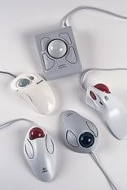
Variants of the
Mouse
➢ Trackballs
❑ Upside down mouse
❑ Hand rests on the ball
❑ User
❑ Uses
moves the ball
little
desk
space
safdar@uetpeshawar.edu.pk
23

Slide 24
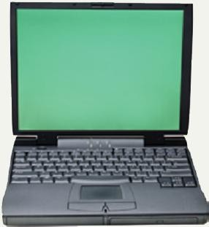
Variants of the Mouse
(cont.)
➢ Track pads
❑ Stationary pointing device
❑ Small plastic rectangle
❑ Finger moves across the pad
❑ Pointer moves according
to
finger
❑ Popular
on
laptops
safdar@uetpeshawar.edu.pk
24

Slide 25
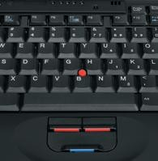
Variants of the Mouse
(cont.)
➢ Track point
❑ Little joystick on the keyboard
❑ Move
pointer
by
moving
the
joystick
safdar@uetpeshawar.edu.pk
25

Slide 26
Ergonomics and Input Devices
➢ Ergonomics
❑ Study of human and tool interaction
❑ Concerned with physical interaction
❑ Attempts to improve safety and comfort
➢ Repetitive Strain Injury (RSI)
❑ Caused by continuous misuse of the body
❑ Many professionals suffer from RSI
➢ Carpal Tunnel Syndrome
❑ Carpal tunnel is a passage in the wrist
❑ Holds nerves and tendons
❑ Prolonged keyboarding swells tendons
o Results in compression of median nerve
safdar@uetpeshawar.edu.pk
26

Slide 27
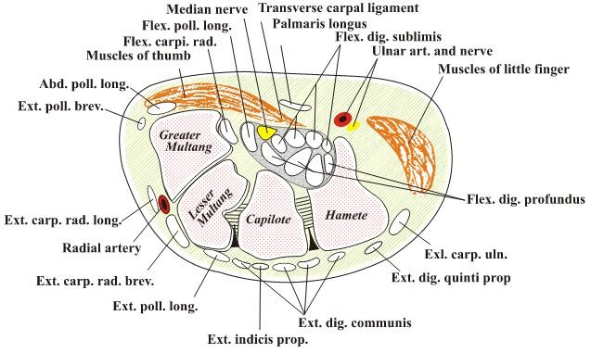
Ergonomics
and
Input
Devices
(cont.)
Source: https://en.wikipedia.org/wiki/Carpal_tunnel_syndrome
safdar@uetpeshawar.edu.pk
27

Slide 28
Ergonomics and Input
Devices
(cont.)
➢ Office hardware suggestions
❑ Office chairs should have armrests
o Adjustable armrests and height
o Lower back support
❑ Desks should have a keyboard tray
o Keep hands at keyboard height
o Place the monitor at eye level (or lower)
safdar@uetpeshawar.edu.pk
28

Slide 29
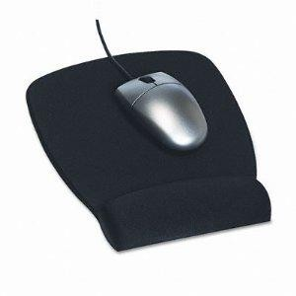

Ergonomics and Input
Devices
(cont.)
➢ Techniques to avoid RSI
❑ Sit up straight
❑ Have a padded wrist support
❑ Keep your arms straight
❑ Keyboard properly
❑ Take
frequent
breaks
Image from http://www.humantech.com/two-things-to-consider-when-using-a-mouse-padwrist-rest
safdar@uetpeshawar.edu.pk
29

Slide 30
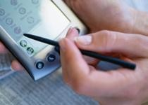
Devices for
the
Hand
➢ Pen based input
❑ Tablet PCs, PDA
❑ Pen used to write data
❑ Pen used as a pointer
❑ Handwriting recognition
❑ On
screen
keyboard
safdar@uetpeshawar.edu.pk
30

Slide 31
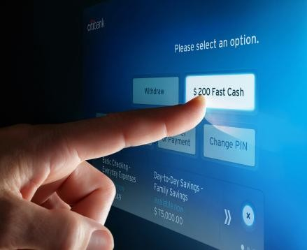
Devices for the Hand (cont.)
➢ Touch screens
❑ Sensors determine where finger points
❑ Sensors create an X,Y coordinate
❑ Usually presents a menu to users
❑ Found in cramped or dirty environments
o Dirt won’t allow keyboard usage
Image from http://www.humantech.com/two-things-to-consider-when-using-a-mouse-padwrist-rest
safdar@uetpeshawar.edu.pk
31

Slide 32
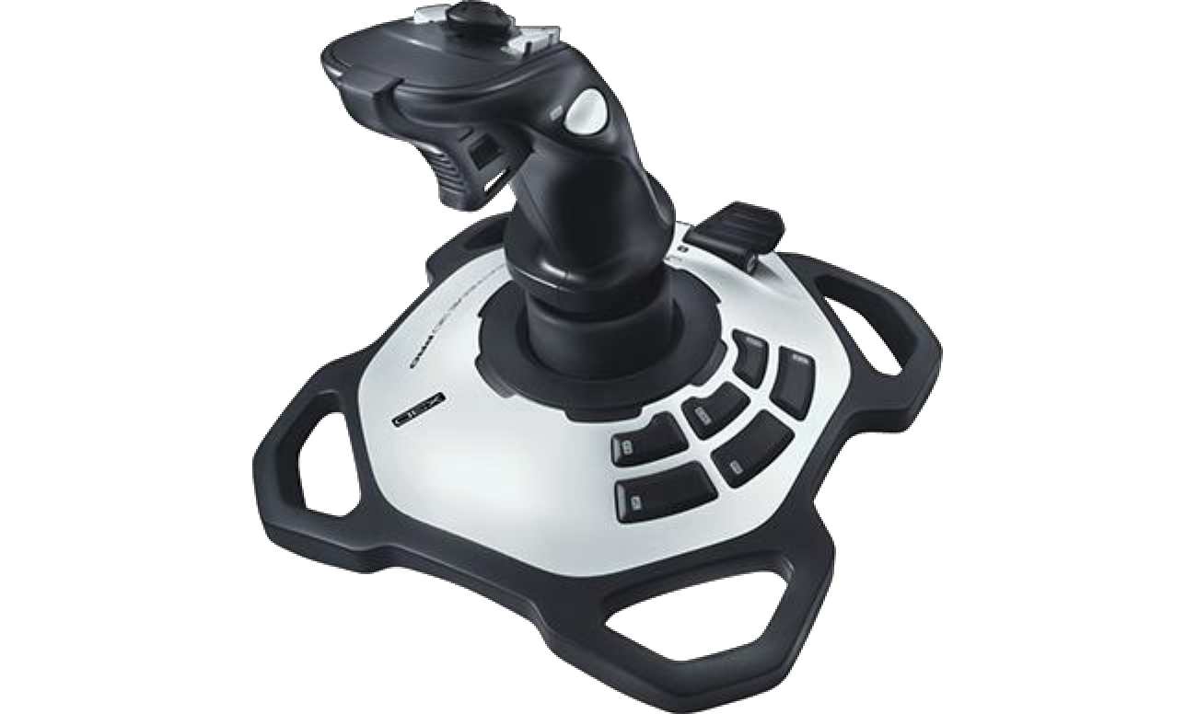
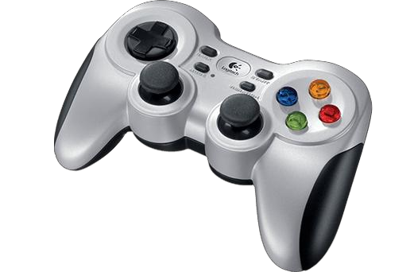
Devices for the
Hand
(cont.)
ce
e game eedback
➢ Game controllers
❑ Enhances gaming experien
❑ Provide custom input to t
❑ Modern controllers
❑ Joystick
offer
❑ Game pad
Images from http://gaming.logitech.com/en-us/gaming-controllers and http://gaming.logitech.com/en-us/product/f710-wireless-gamepad
safdar@uetpeshawar.edu.pk
32

Slide 33
Optical Input Devices
➢ Allows the computer to see input
➢ Bar code readers
❑ Converts bar codes to numbers
o UPC (Universal Product Code)
❑ Computer find number in a database
❑ Works by reflecting light
o Amount of reflected light indicates number
safdar@uetpeshawar.edu.pk
33

Slide 34
Optical Input Devices
(cont.)
➢ Image scanners
❑ Converts printed media into electronic
❑ Reflects light off of the image
❑ Sensors read the intensity
❑ Filters determine color depths
➢ Optical character recognition (OCR)
❑ Converts scanned text into editable text
❑ Each letter is scanned
❑ Letters are compared to known letters
❑ Best match is entered
❑ Rarely 100% accurate
into
document
safdar@uetpeshawar.edu.pk
34

Slide 35
Audiovisual Input Devices
➢ Microphones
❑ Used to record speech
❑ Speech recognition
o “Understands” human speech
o Allows dictation or control of computer
o Matches spoken sound to known phonemes
o Enters best match into document
safdar@uetpeshawar.edu.pk
35

Slide 36
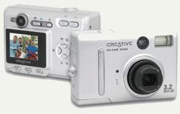
Audiovisual Input Devices
(cont.)
➢ Digital cameras
❑ Captures images electronically
❑ No film is needed
❑ Image is stored as a JPG file
❑ Memory cards store the images
❑ Used
in
a
variety
of
professions
safdar@uetpeshawar.edu.pk
36

